Slide 1
EUC : Pillar of An IT
5thAug

Slide 2




Agenda
Offshore Onsite Co-ordination
Team Introduction
A day in life of team!
Improvements & Initiative

Slide 3
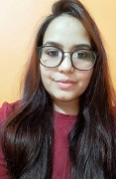
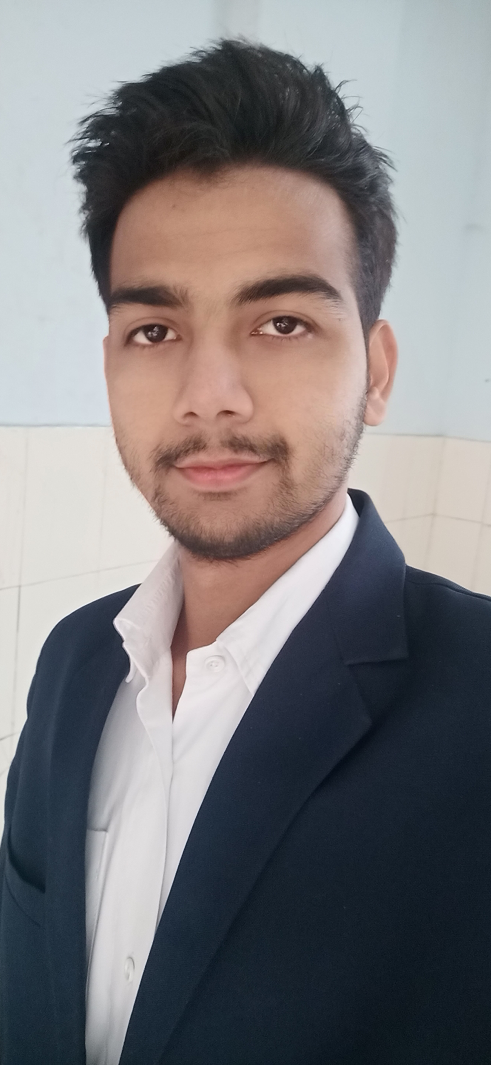
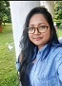

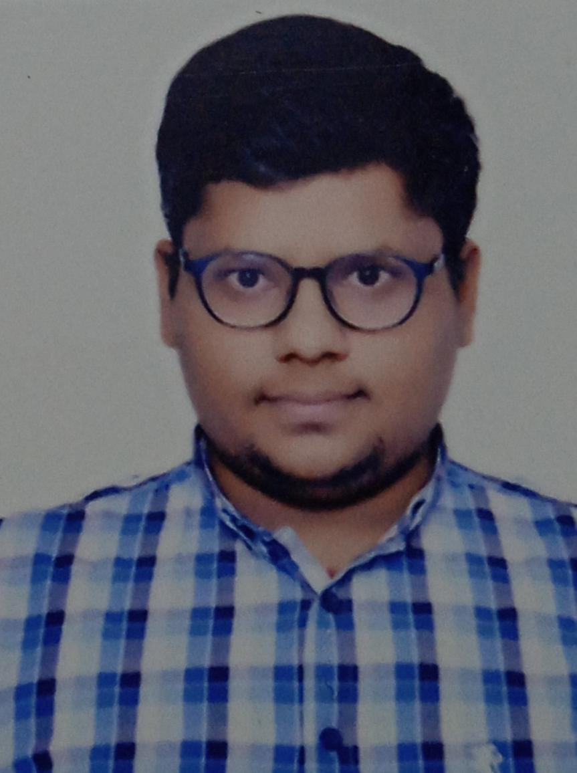
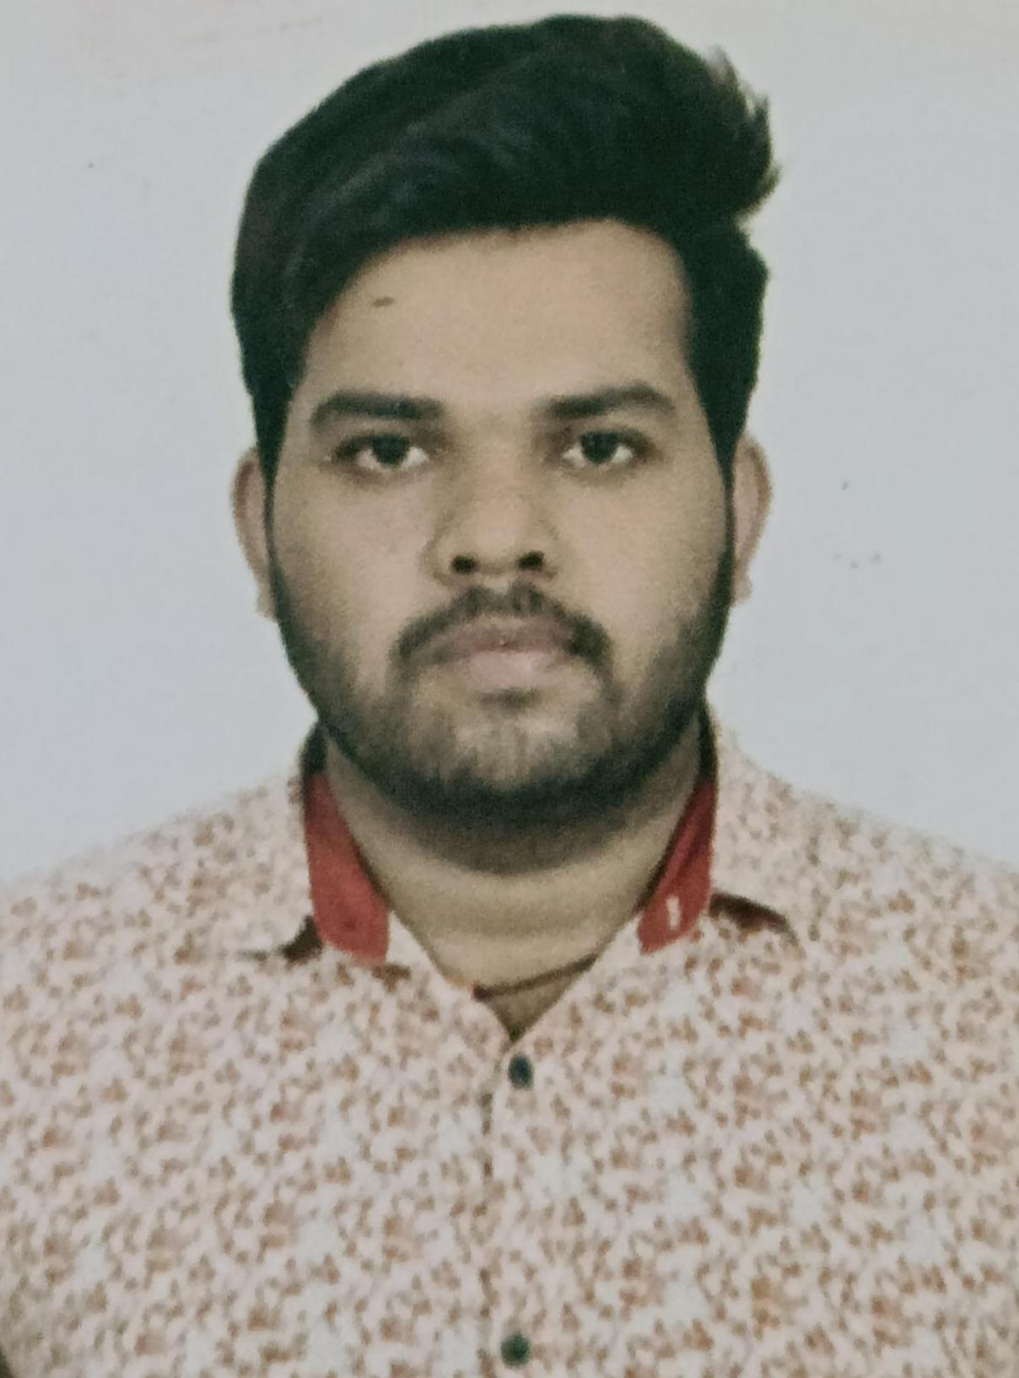
EUC Warriors
Smita Singh
An Optimist Leader
Ashutosh Singh: A Challenger Citrix and Antivirus Expert
Rupa Mallik: Tech Savvy
Forcepoint $ SCCM Expert
Vivek Bansal:
Rahul Singh: An all rounder with an expertise in Citrix and Antivirus.

Slide 4



Rupa Malik
Tech Savvy
Forcepoint $ SCCM Expert
MEET OUR TEAM
Anjali Gupta
Tech Savvy
Forcepoint $ SCCM Expert
Ashutosh Singh
A Challenger Citrix and Antivirus Expert
Rahul Singh
An all rounder with an expertise in Citrix and Antivirus.
Vivek Bansal
An all rounder with an expertise in Citrix.
Team Lead
An Optimist Leader
Ravi Dev Pal
An all rounder with an expertise in Citrix.

Slide 5
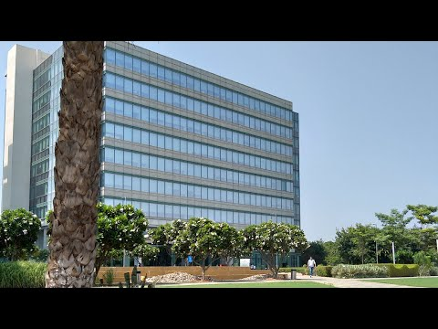
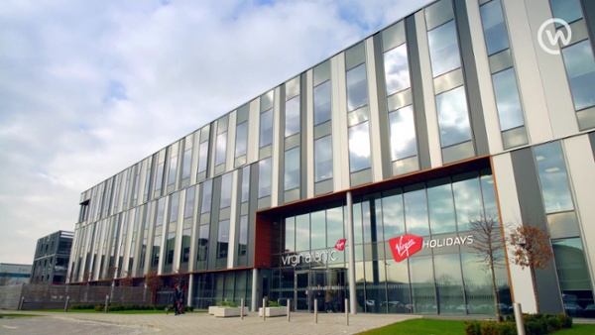

Secret Ingredient – Offshore & Onsite connect
ONSITE
OFFSHORE
Team Work: Both onsite and offshore teams work together to sort as user issue keeping customer satisfaction as key goal.
Tcs Weekly connect: Helps in enhancing bon between offshore and onsite team

Slide 6




A day in life of Team!
Queue Management; Proper management of incident , Request and problem tickets.
Customer Centric: keeping customer satisfaction as key goal, we work as team to resolve different technical issue faced by users at topmost priority.
Daily stand up operations meeting to sort day to day challenges.
Refresher Session: Refreshers sessions conducted to enhance technical skills
EUC Daily Connect: Discuss complicated incidents or request and enhance team bonding.
Win
Analyse
Focus
Solve puzzle
Onsite/Customer Connect
Collaborate

Slide 7
New Improvements and initiatives
point1
point2
point3
point4

Slide 8



Open For All

Slide 9


